Slide 1
Systems of Linear Equations in two variables (4.1)
Solve by graphing
Solve using substitution
Solve by elimination by addition
Applications

Slide 2
Opening example
A restaurant serves two types of fish dinners- small for $5.99 each and a large order for $8.99. One day, there were 134 total orders of fish and the total receipts for these 134 orders was $1024.66. How many small orders and how many large fish plates were ordered?

Slide 3
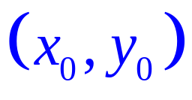
Systems of Two Equations in Two variables
Given the linear system
ax + by = c
dx + ey = f
A solution is an ordered pair
that will satisfy each equation (make a true equation when substituted into that equation). The solution set is the set of all ordered pairs that satisfy both equations. In this section, we wish to find the solution set of a system of linear equations.

Slide 4
Solve by graphing
One method to find the solution of a system of linear equations is to graph each equation on a coordinate plane and to determine the point of intersection (if it exists). The drawback of this method is that it is not very accurate in most cases, but does give a general location of the point of intersection. Lets take a look at an example:
Solve the system by graphing:
3x + 5y = -9
x+ 4y = -10

Slide 5
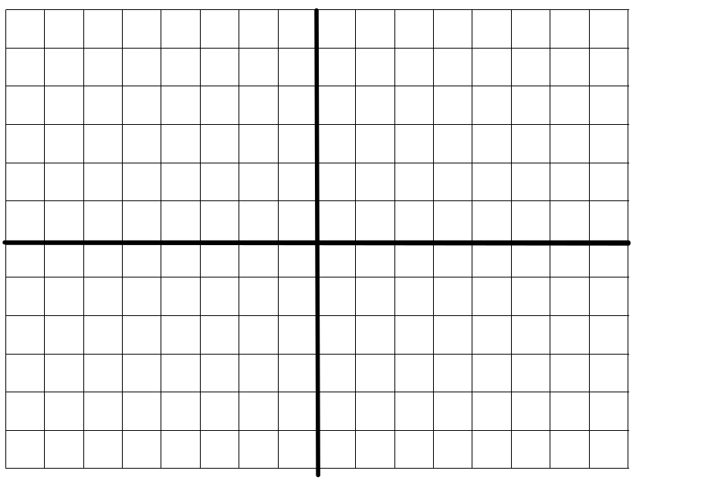
Solve by graphing
3x + 5y = -9
x+ 4y = -10
Intercept method:
If x = 0, y= -9/5
If y = 0 , x = - 3
Plot points and draw line
Second line:
(0, -5/2) , ( -10,0)
From the graph we see that the point of intersection is (2,-3).
Check: 3(2)+5(-3)= -9 and 2+4(-3)= -10 both check.
(2,-3)

Slide 6
Another example:
Now, you try one:
Solve the system by graphing:
2x+3 =y
X+2y = -4
The solution is (-2,-1)

Slide 7
Method of Substitution
Although the method of graphing is intuitive, it is not very accurate in most cases. There is another method that is 100% accurate- it is called the method of substitution. This method is an algebraic one. This method works well when the coefficients of x or y are either 1 or -1. For example, let’s solve the previous system
2x + 3 = y
X + 2y = -4
using the method of substitution. This steps for this method are as follows:
1) Solve one of the equations for either x or y.
2) Substitute that result into the other equation to obtain an equation in a single variable ( either x or y).
3) Solve the equation for that variable.
4. Substitute this value into any convenient equation to obtain the value of the remaining variable.

Slide 8
Method of substitution
2x+3 = y
x +2y =-4
x + 2(2x+3) =-4
x +4x+6 = -4
5x+6 = -4
5x = -10
x = -2
If x = -2 then from the first equation, we have 2(-2)+3 = y or
-1 = y . Our solution is
(-2, -1)

Slide 9
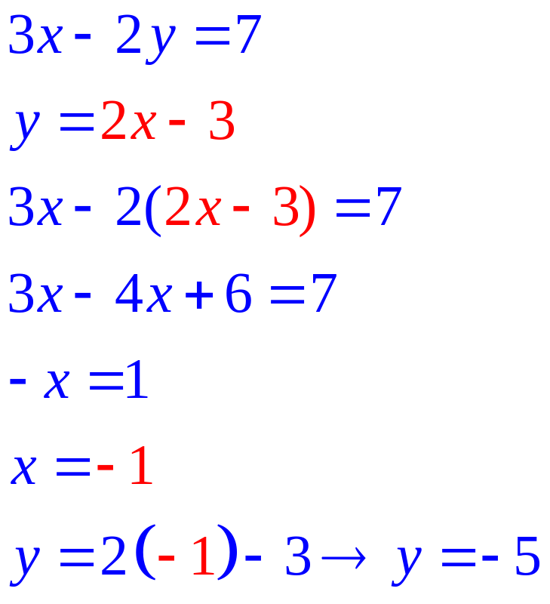
Another example:
Solve the system using substitution:
3x-2y=-7
y = 2x -3
Solution:

Slide 10
Terminology:
1. A consistent linear system is one that has one or more solutions.
  A) If a consistent system has exactly one solution then it is said to be independent. An independent system will occur when two lines have different slopes.
  B) if a consistent system has more than one solution, then it is said to be dependent. A dependent system will occur when two lines have the same slope and the same y intercept. In other words, the two equations are identical. The graphs of the lines will coincide with one another and there will be an infinite number of points of intersection.
2. An inconsistent linear system is one that has no solutions. This will occur when two lines have the same slope but different y intercepts. In this case, the lines will be parallel and will never intersect.

Slide 11
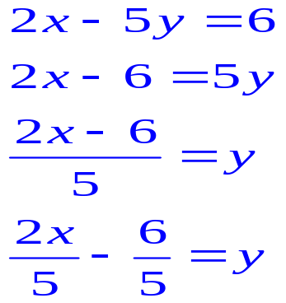
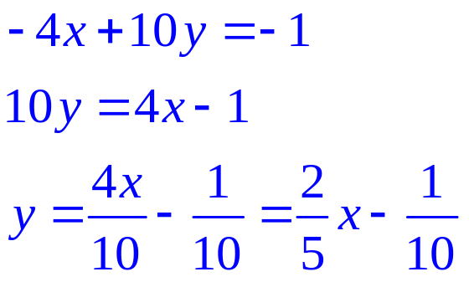
An example:
Determine if the system is consistent, independent, dependent or inconsistent:
1) 2x – 5y = 6
-4x + 10y = -1
Solve each equation for y to obtain the slope intercept form of the equation:
Since each equation has the same slope but different y intercepts, they will not intersect. This is an inconsistent system

Slide 12
Elimination by Addition
The method of substitution is not preferable if none of the coefficients of x and y are 1 or -1. For example, substitution is not the preferred method for the system below: 2x – 7y=3
  -5x + 3y = 7
  A better method is elimination by addition: First of all, we need to know what operations can be used to produce equivalent systems. They are as follows:
  1) Two equations can be interchanged.
  2. An equation is multiplied by a non-zero constant.
  3. An equation is multiplied by a non-zero constant and then added to another equation.

Slide 13
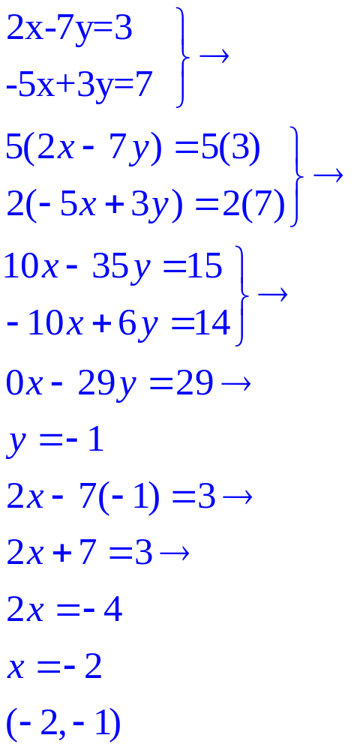
Elimination by Addition
For our system, we will seek to eliminate the x variable. The coefficients of the x variables are 2 and -5. The least common multiple of 2 and 5 is 10. Our goal is to obtain coefficients of x that are additive inverses of each other.
We can accomplish this by multiplying the first equation by 5
Multiply second equation by 2.
Next, we can add the two equations to eliminate the x-variable.
Solve for y
Substitute y value into original equation and solve for x
Write solution as an ordered pair
S:
2x – 7y = 3

Slide 14
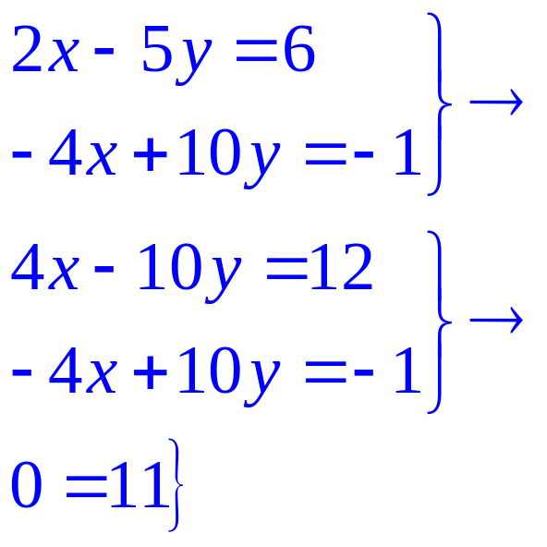
Solve using elimination by addition
Solve 2x-5y = 6
-4x+10y=-1
1. Eliminate x by multiplying equation 1 by 2 .
2. Add two equations
3. Upon adding the equations, both variables are eliminated producing the false equation
0 = 11
4. Conclusion: If a false equation arises, the system is inconsistent and there is no solution.
Solution:

Slide 15
Applications
A man walks at a rate of 3 miles per hour and jogs at a rate of 5 miles per hour. He walks and jogs a total distance of 3.5 miles in 0.9 hours. How long does the man jog?
Solution: Let x represent the amount of time spent walking and y represent the amount of time spent jogging. Since the total time spent walking and jogging is 0.9 hours, we have the equation
x +y = 0.9 . We are given the total distance traveled as 3.5 miles. Since Distance = Rate x time, we have [distance walking] + [distance jogging] = [total distance] . Distance walking = 3x and distance jogging = 5y. Then [distance walking] plus [distance jogging] 3x+5y= 3.5.

Slide 16
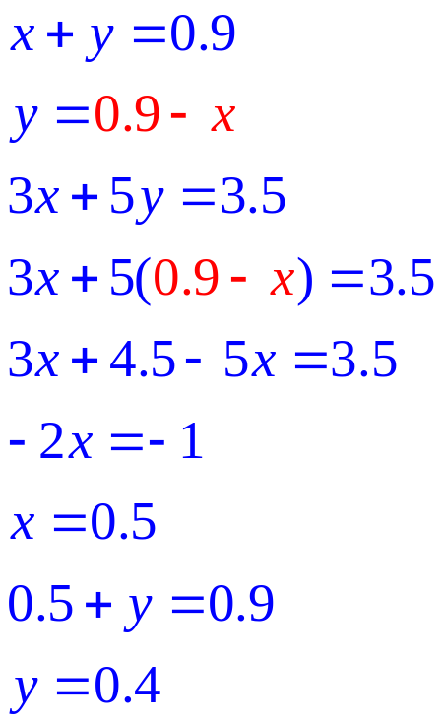
Application continued
We can solve the system using substitution.
1. Solve the first equation for y
2. Substitute this expression into the second equation.
3. Solve 2nd equation for x
4. Use this x value to find the y value
5. Answer the question.
6. Time spent jogging is 0.4 hours.
Solution:

Slide 17
Now, solve the opening example:
A restaurant serves two types of fish dinners- small for $5.99 each and a large order for $8.99. One day, there were 134 total orders of fish and the total receipts for these 134 orders was $1024.66. How many small orders and how many large fish plates were ordered? (60 small orders and 74 large orders)

